Slide 1

Computer Graphics
Lecture-3

Slide 2
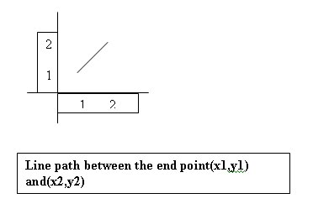
Line Equation
The Cartesian slop-intercept equation for a straight line is
y=mx+b ------ (1)
with m->slope, b->y intercept
The 2 end points of a line segment are specified at a position(x1,y1) and (x2,y2).

Slide 3
Line DDA Algorithm
The digital differential analyzer(DDA) is a scan conversion line algorithm based on calculation either Dy or Dx.
The line at unit intervals is one coordinate and determine corresponding integer values nearest line for the other coordinate.
Consider first a line with positive slope.

Slide 4
Step : 1
If the slope is less than or equal to 1, the unit x intervals D_{x} =1 and compute each successive y values.
D_{x} =1
m= D_{y} / D_{x}
m = ( y₂ – y₁ ) / 1
m = (y_{k+1} – y_{k})/ 1
y_{k+1} = y_{k} + m

Slide 5
Step : 2
If the slope is greater than 1, the roles of x any y at the unit y intervals D_{y} =1 and compute each successive x values.
D_{y} =1
m= D_{y} / D_{x}
m = 1 / (x₂ – x₁ )
m = 1 / (x_{k+1} – x_{k})
x_{k+1} = x_{k} + (1/m)

Slide 6
Step : 3
If the processing is reversed, the starting point at the right
D_{x} =-1
m= D_{y} / D_{x}
m = ( y₂ – y₁ ) / -1
y_{k+1} = y_{k} - m

Slide 7
Step : 4
Here, D_{y} =-1
m= D_{y} / D_{x}
m = -1 / (x₂ – x₁ )
m = -1 / (x_{k+1} – x_{k})
x_{k+1} = x_{k} – (1/m)

